Slide 1
Input and output in 8086 Assembly Language

Slide 2
dos/info/interNNp.zip
AH | Description | AH | Description
01 | Read character from STDIN | 02 | Write character to STDOUT
05 | Write character to printer | 06 | Console Input/Output
07 | Direct char read (STDIN), no echo | 08 | Char read from STDIN, no echo
09 | Write string to STDOUT | 0A | Buffered input
0B | Get STDIN status | 0C | Flush buffer for STDIN
0D | Disk reset | 0E | Select default drive
19 | Get current default drive | 25 | Set interrupt vector
2A | Get system date | 2B | Set system date
2C | Get system time | 2D | Set system time
2E | Set verify flag | 30 | Get DOS version
35 | Get Interrupt vector
36 | Get free disk space | 39 | Create subdirectory
3A | Remove subdirectory | 3B | Set working directory
3C | Create file | 3D | Open file
3E | Close file | 3F | Read file
40 | Write file | 41 | Delete file
42 | Seek file | 43 | Get/Set file attributes
47 | Get current directory | 4C | Exit program
4D | Get return code | 54 | Get verify flag
56 | Rename file | 57 | Get/Set file date

Slide 3
Character Input
The task here is to read a single character from the keyboard. There are also three elements involved in performing character input:
As for character input, we specify which of MS-DOS’s I/O subprograms we wish to use, i.e. the character input from the keyboard subprogram. This is MS-DOS subprogram number 1h. This number must be stored in the ah register.
We call MS-DOS to carry out the I/O operation using the int instruction as for character input.
The MS-DOS subprogram uses the al register to store the character it reads from the keyboard.

Slide 4
Example: Write a code fragment to read a character from the keyboard: character input with echo
mov ah, 1h ; keyboard input subprogram
int 21h ; character input ; character is stored in al mov cl, al ; copy character from al to c

Slide 5
Character input without echo:
MOV AH, 08H
INT 21H
This instruction reads a character from the keyboard without echoing it on the screen or waits until character is available. AL register contains the character input.

Slide 6
Character Output
The task here is to display a single character on the screen. There are three elements involved in carrying out this operation using the int instruction:
We specify the character to be displayed. This is done by storing the character’s ASCII code in a specific 8086 register. In this case we use the dl register, i.e. we use dl to pass a parameter to the output subprogram.
We specify which of MS-DOS’s I/O subprograms we wish to use. The subprogram to display a character is subprogram number 2h. This number is stored in the ah register.
We request MS-DOS to carry out the I/O operation using the int instruction. This means that we interrupt our program and transfer control to the MS-DOS subprogram that we have specified using the ah register.

Slide 7
Example: Write a code fragment to display the character ’a’ on the screen:
mov dl, ‘a‘ ; dl = ‘a‘ mov ah, 2h ; character output subprogram int 21h ; call ms-dos output character

Slide 8
String output
The task here is to display a string(Array of characters) on the screen. There are four elements involved in carrying out this operation using the INT instruction:
Under the data segment, we define a variable to serve as the starting address for the string, array of characters or ASCII codes ending with '$'. e.g message DB "Your text goes here",'$' OR message DB 'Y','o','u','r',' ','t','e','x','t',' ','g','o','e','s',' ','h','e','r','e','$' ;Pretty long huh? OR message DB 89,111,117,114, ... ,$ ;In ASCII codes.
where message is the name of the variable, DB means "Define byte", '$' indicates end of string, and the digits are the ASCII code of the characters.

Slide 9
2. Under the code segment(also explained in next post), enter
MOV AX, @data MOV DS, AX ; to initialize the DS register
This moves the address of your data in memory to register DS. then, offset the variable to DX for display i.e MOV DX, OFFSET message

Slide 10
3. We specify which of MS-DOS’s I/O subprograms we wish to use. The subprogram to display a string is subprogram number 9h. This number is stored in the ah register.
4. We request MS-DOS to carry out the I/O operation using the int instruction. This means that we interrupt our program and transfer control to the MS-DOS subprogram that we have specified using the ah register.

Slide 11
Example 4 .data notice DB "Hello world",13,10,'$' .code start: MOV AX, @data MOV DS, AX MOV DX, offset notice ;Copies notice address to DX for display MOV AH, 09H INT 21H ;Calls MS-DOS to display string MOV AX, 4C00H ;Returns control to MS-DOS INT 21H END start

Slide 12
String input
The task here is to input a string(Array of characters) from the keyboard. There are four elements involved in carrying out this operation using the int instruction:
1. Under the data segment, we define the variable to contain the string. e.g message DB ? where message is the name of the variable, DB means "Define byte", ? indicates the memory created should be empty.

Slide 13
2. Under the code segment(also explained in next post), enter MOV AX, @data MOV DS, AX to initialize the DS register
This moves the address of your data in memory to register DS. then, offset the variable to DX i.e MOV DX, OFFSET message

Slide 14
3. We specify which of MS-DOS’s I/O subprograms we wish to use. The subprogram to display a string is subprogram number 3FH. This number is stored in the ah register.
4. We request MS-DOS to carry out the I/O operation using the int instruction. This means that we interrupt our program and transfer control to the MS-DOS subprogram that we have specified using the ah register.

Slide 16
Example
data value DB ? .code start: MOV AX, @data MOV DS, AX MOV DX, OFFSET value ;Copies notice address to DX for display MOV AH, 3FH INT 21H ;Calls MS-DOS to input string MOV AH, 4C00H ;Returns control to MS-DOS INT 21H END start ;End of program.

Slide 17
The program will simply prompt you to enter a string and exits. ;The string will be stored in memory starting from the address of the variable you declared(value). ;Note: in this case, CARRIAGE-RETURN (ASCII code 13) or LINE-FEED (ASCII code 10) indicates the end of the string.

Slide 18
Inputting text using int 21h AH=0Ah
This Buffered STDIN Input function gets characters from the keyboard and continues doing so until the user presses the Enter key.
All characters and the final carriage return are placed in the storage space that starts at the 3rd byte of the input buffer supplied by the calling program via the pointer in DS:DX
The character count, not including the final carriage return, is stored in the 2nd byte of the input buffer
It's the responsibility of the calling program to tell DOS how large the storage space is. Therefore you must put its length in the 1st byte of the input buffer before calling this function
To allow for an input of 1 character you set the storage size at 2
To allow for an input of 254 characters you set the storage size at 255.

Slide 19
mov si, msg1 call WriteStringDOS mov dx, buf mov ah, 0Ah ;DOS.BufferedInput int 21h mov si, msg2 call WriteStringDOS mov si, buf+2 movzx bx, byte [si-1] ;Get character count mov word [si+bx+1], 10 ;Keep CR, append LF and 0 call WriteStringDOS mov ax, 4C00h ;DOS.TerminateWithExitcode int 21h | WriteStringDOS: pusha jmps .b .a: mov dl, al mov ah, 02h ;DOS.DisplayCharacter int 21h ; -> AL .b: lodsb test al, al jnz .a popa ret buf: db 255, 16, "I'm the template", 13, 255-16-1+2 dup (0)

Slide 20
Inputting text using int 21h AH=3Fh

Slide 21
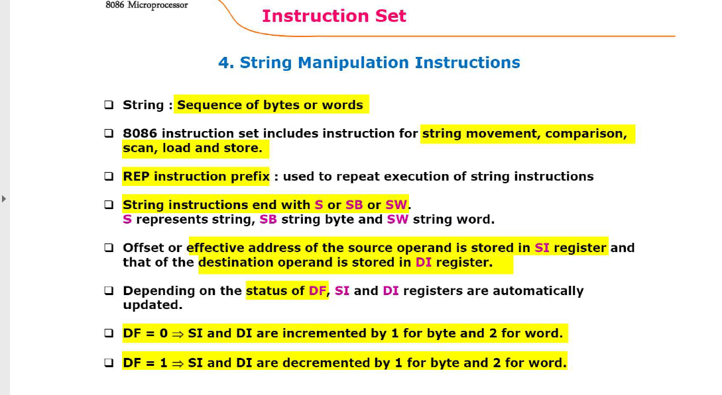

Slide 22
REP
REP is a prefix written before one of the string instructions.
It is used for repeating an instruction count number of times, where count is stored in the CX register.
After every operation the CX register is decremented and the zero flag is tested; the process continues till CX = 0.
Usage REP <String-Instruction>

Slide 23
MOVSB: -
MOVSB instruction will perform all the actions in repeat unit loop. -
The MOVSB instruction will copy a byte from the location pointed to by the Direct Index Register.
This instruction copies a byte or a word from a location in the data segment [DS:SI] to a location in the extra segment [ES:DI].
The offset in the data segment for the source is to be stored in the SI register and the offset for the destination in the extra segment is to be stored in the DI register.
For multiple byte/word movement, the value stored in the CX register by the user functions as a counter. After each move, SI and DI are automatically adjusted to point to the next source and destination respectively.

Slide 24
The Direction Flag (DF) value determines whether SI and DI are to be incremented (DF = 0) or decremented (DF = 1) after each move.
Usage MOVS dest, src (This usage is misleading; movement of data still happens from DS:SI to ES:DI)
MOVSB

Slide 25
To move a string of length 4 bytes from SRC to DST
MOV SI, SRC
MOV DI, DST
MOV CX, 04H
CLD; Clear the direction flag
REP MOVSB

Slide 26
The MOVSW instruction
The MOVSW (move string, word) instruction fetches the word at address SI, stores it at address DI and then increments or decrements SI and DI by two.
The MOVSD instruction
The MOVSD (move string, double word) instruction fetches the double word at address SI, stores it at address DI and then increments or decrements SI and DI by four.
Let us consider the case of moving (i.e. copying) an array Array1 from one location to another location Array2, assuming the number of elements to move is 100 byte

Slide 27
If we use the normal MOV instructions, the program would look like:
Example: Copy 100 bytes from Array1 to Array2, using the MOV instruction.
LEA DI, Array2 ; Starting address of Destination LEA SI, Array1 ; Starting address of Source MOV CX, 100 ; Number of elements = 100 Next: MOV AL, [SI] ; AL <== [SI] MOV [DI], AL ; [DI] <== AL INC SI ; SI + 1 INC DI ; DI + 1 LOOP Next ; Next element ...

Slide 28
owever, If the string instructions are used, the code would be:
REP Prefix
Example: Copy 100 bytes from Array1 to Array2, using MOVSB instruction.
LEA DI, Array2 ; Starting address of Destination LEA SI, Array1 ; Starting address of Source MOV CX, 100 ; Number of elements = 100 PUSH DS POP ES ; make ES=DS CLD ; set SI and DI to auto-increment next: MOVSB LOOP next

Slide 29
With REP
Example: Copy 100 bytes from Array1 to Array2, using MOVSB instruction with the REP prefix.
LEA DI, Array2 ; Starting address of Destination LEA SI, Array1 ; Starting address of Source MOV CX, 100 ; Number of elements = 100 PUSH DS POP ES ; make ES=DS CLD ; set SI and DI to auto-increment REP MOVSB

Slide 30
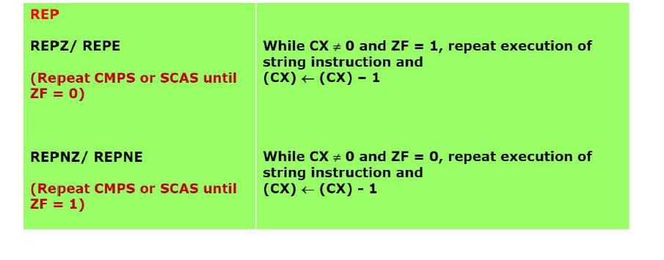

Slide 31
CMPS/CMPSB/CMPSW
The CMPSB(W) instruction can be used to compare a byte(word) in one string (DS:offset in SI) with a byte (word) in another string (ES:offset in DI). The comparison is executed by subtracting the byte (word) in DI from the byte (word) in SI.
The Direction Flag (DF) value determines whether SI and DI are to be incremented (DF = 0) or decremented (DF = 1) after each move. Increments/decrements happen by 1 for byte strings and by 2 for word strings.
The CMPSB(W) instruction is almost always used with a REP(E/Z) prefix to compare multiple words/bytes.
The result of the comparison can be gleaned from flag updates.

Slide 32
Usage CMPS src, dest
CMPSB CMPSW
Flags AF,CF,OF,PF,SF,ZF

Slide 33
SCAS/SCASB/SCASW
SCAS(/B/W) compares a byte in AL or a word in AX with a byte or word pointed to by DI in ES. The direction flag determines the direction of scan.Used with the REP prefix to find the first occurrence of a specified byte(word) in a string.
Usage SCAS <String>
SCASB
SCASW
Flags AF,PF,OF,PF,SF,ZF

Slide 34
Example
Scan a string STR of 100 characters for the 'space' character, 20H
MOV CX, 100
MOV DI, offset STR
MOV AL, 20H
REPNE SCASB

Slide 35
LODS/LODSB/LODSW
This instruction copies a byte (word) of string from the location pointed to by SI. The SI value is automatically incremented (depending on the DF value) after each movement by 1 byte (2 bytes) for a byte string (word string).
This instruction is preferred over MOV for string manipulation due to its treatment of the SI pointer and the ability to use it with REP prefixes.
Usage LODS <String>
LODSB
LODSW
Flags None

Slide 36
Example
CLD
MOV SI, Offset STR
LODSB

Slide 37
STOS/STOSB/STOSW
The STOS instruction copies a byte (word) from AL (AX) to a memory location stored in [ES:DI]. DI is automatically incremented after the copy, the DF determines the increment/decrement.
In effect, it replaces a string element with a byte (word) from AL (AX).
Usage STOS <String>
STOSB
STOSW

Slide 38
Example
Copy AX to STR
MOV DI, offset STR
STOSW

Slide 39
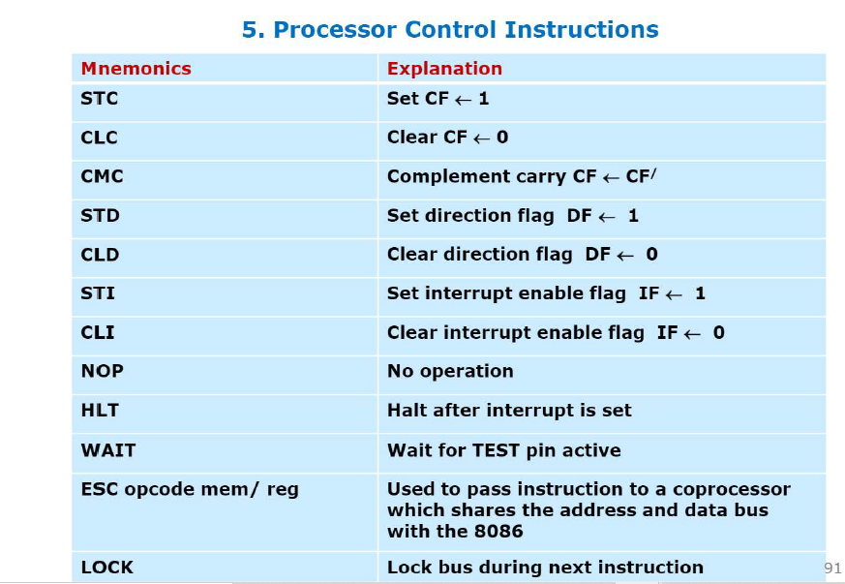

Slide 40
XADD
EXCHANGE AND ADD DESCRIPTION: The XADD instruction adds the source to the destination and stores the sum in the destination, as with any addition. The difference is that after the addition takes place, the original value of the destination is copied into source operand. USAGE: XADD dest, src FLAGS: AF CF OF PF SF ZF

Slide 41
EXAMPLE:
If BL=12H and DL=02H,
XADD BL,DL
Now BL= 14H and DL= 12H

Slide 42
XLAT(B)
Replaces the byte in AL with byte from a user table addressed by BX. Before the XLAT instruction can be executed, the lookup table containing the values for the new code must be put in memory, and the offset of the starting address of the lookup table must be loaded in BX. The best way to describe this is MOV AL,[BX+AL].
Usage XLATB
Example
XLATB Set AL to memory byte DS:[(E)BX + unsigned AL]

Slide 43
https://sites.google.com/site/microprocessorsbits/home
For list of instruction used in the class

